Slide 1
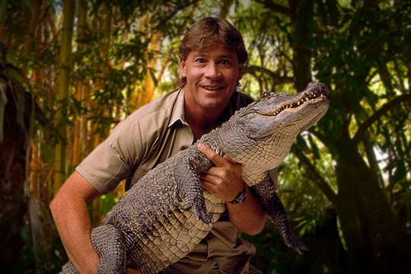
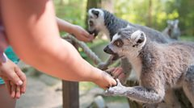
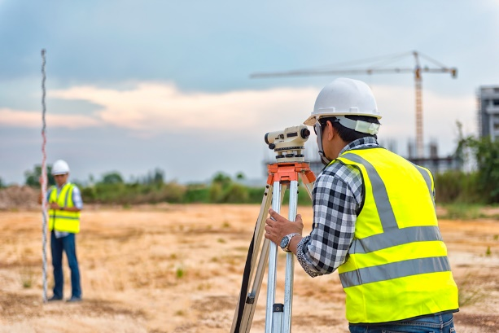
My future as a Geographer
Cabin Crew
Gardener
Conservationist
Meteorologist
Geography
Teacher
Ecologist
Landscape Architecture
Surveyor
What great heights will my skills take me to?

